Slide 1


Santa Rosa Marble
Doral, United States
February 2021
Hiram Fleitas
Fleitas Arts
github.com/hfleitas/srm
Notes:
Image ref: https://img-prod-cms-rt-microsoft-com.akamaized.net/cms/api/am/imageFileData/RE2x0JM?ver=a32f&q=90&m=6&h=600&w=1600&b=%23FFFFFFFF&l=f&o=t&aim=true

Slide 2
SRM App
Customer Use-Case
Search
Product
Inventory
Sales
Hiram Fleitas
Fleitas Arts
github.com/hfleitas/srm
Notes:
Image ref: https://img-prod-cms-rt-microsoft-com.akamaized.net/cms/api/am/imageFileData/RE2x0JM?ver=a32f&q=90&m=6&h=600&w=1600&b=%23FFFFFFFF&l=f&o=t&aim=true

Slide 3











Hiram Fleitas
Owner Fleitas Arts
Bio
Father
Principal DB Architect
Power Platform since 2016
Developer since 1995
SQL Server since 1999
USCG Auxiliary Flotilla Staff Officer
@hiramfleitas
/hfleitas
hiram@fleitasarts.com
hiramfleitas
fleitasarts.com

Slide 4
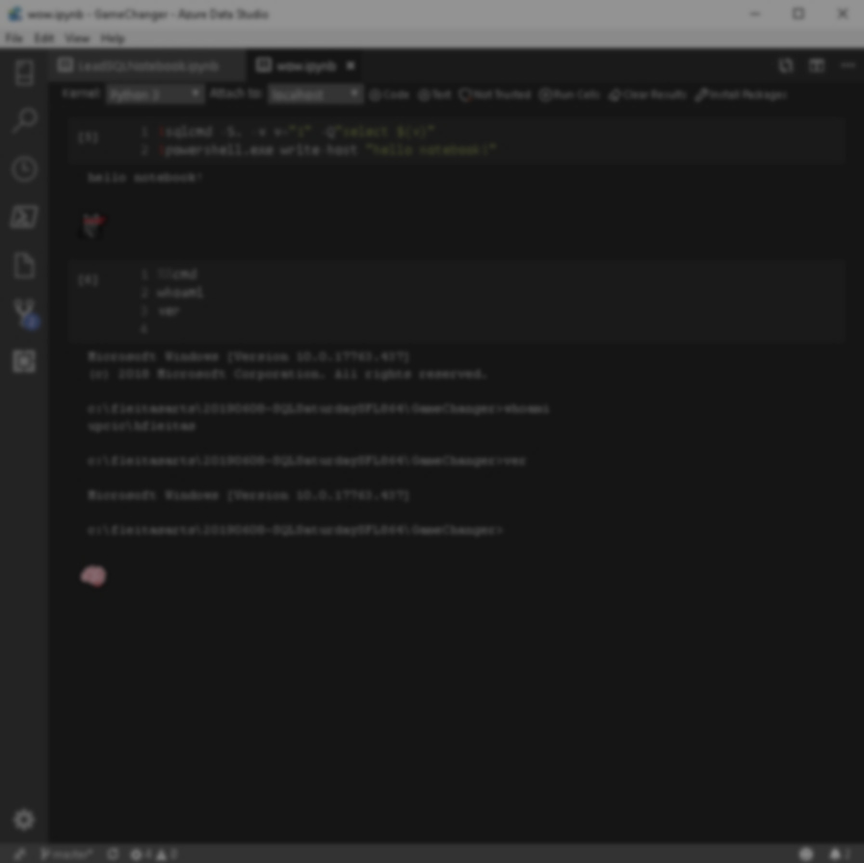

Agenda
Search
Details
Photos
Edit
Add
Cart
Resources

Slide 5

Adapt. Now more than ever.
Work together to meet challenges effectively.
188%
ROI over three years
3.2 hours/week
Average improvement in line-of-business employee productivity
74%
Reduction in app development costs
Notes:
hero_desktop.jpg (2880×1662) (azureedge.net)
https://go.microsoft.com/fwlink/?LinkId=2126953&clcid=0x409

Slide 6

Home

Slide 7
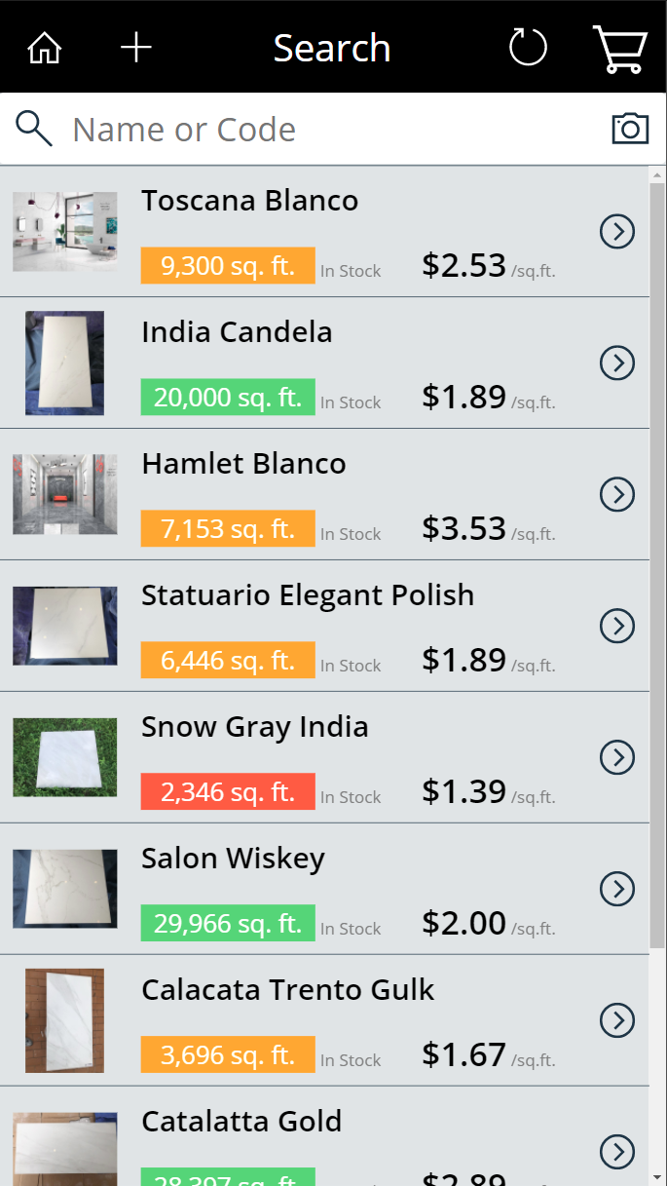
Search

Slide 8
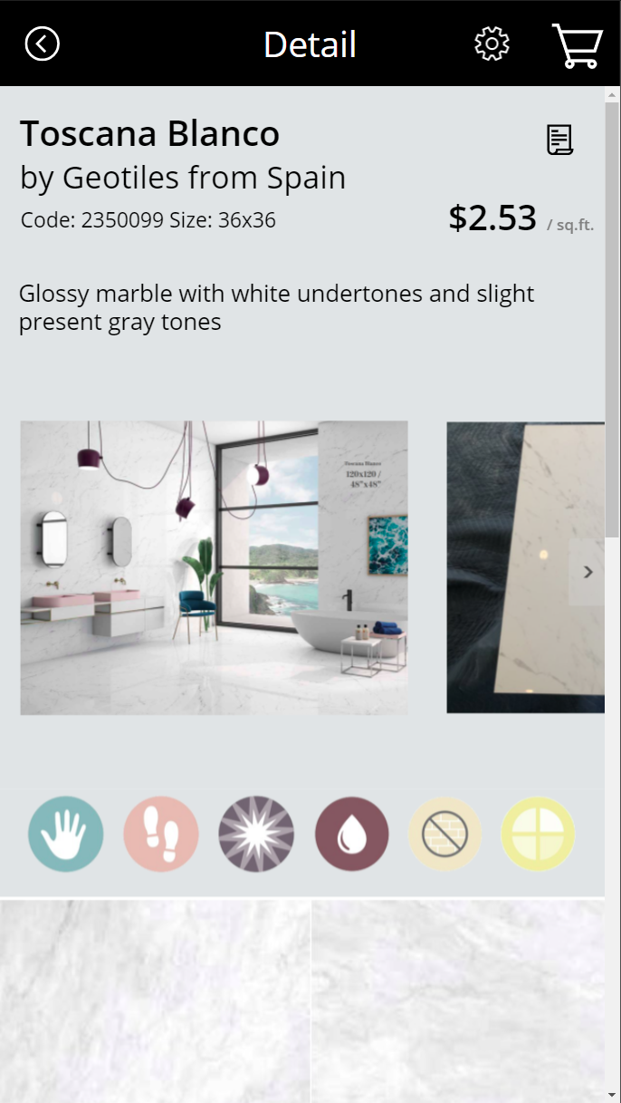
Detail

Slide 9
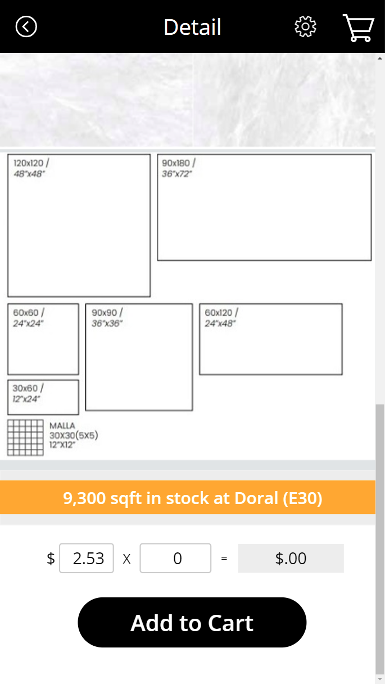
Detail

Slide 10
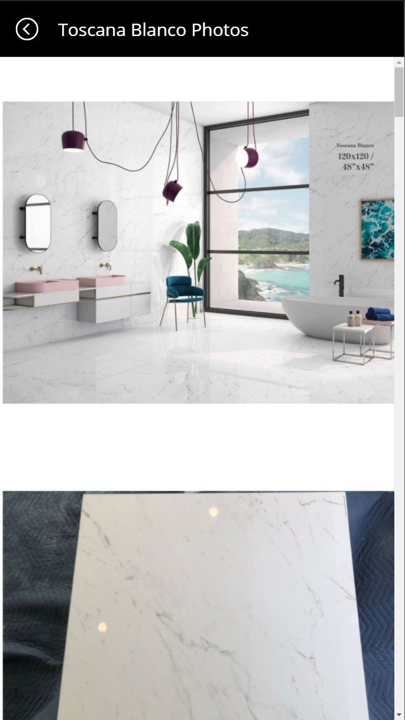
Photos

Slide 11
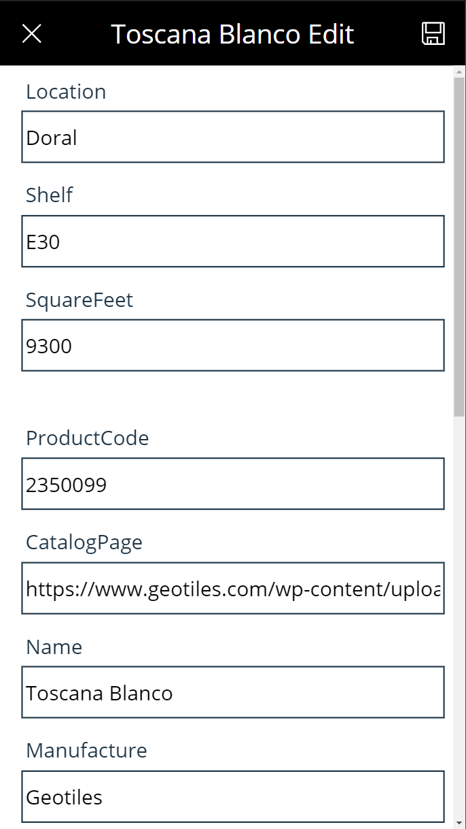
Edit

Slide 12
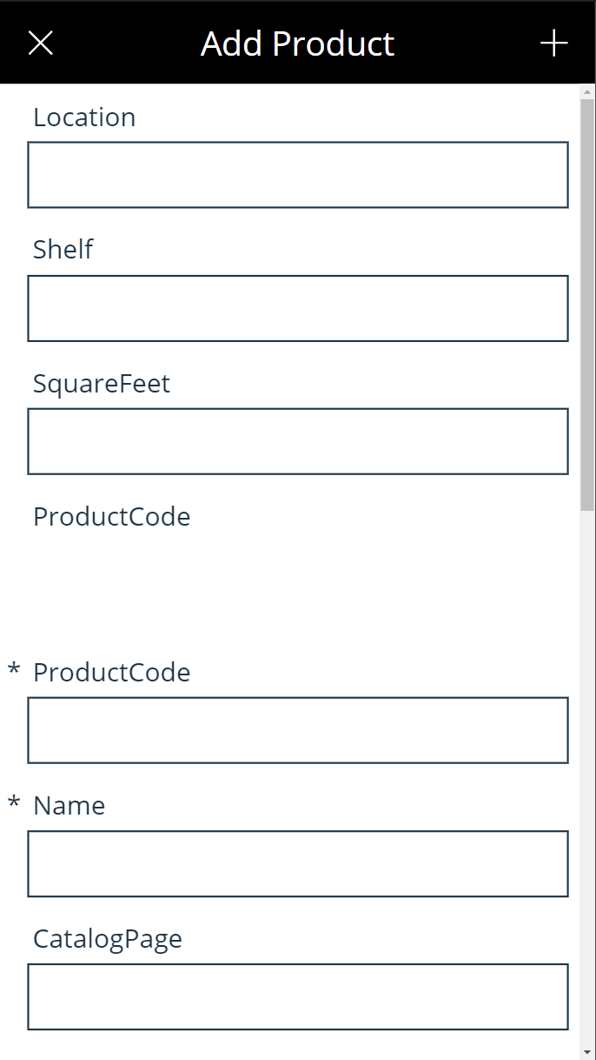
Add

Slide 13
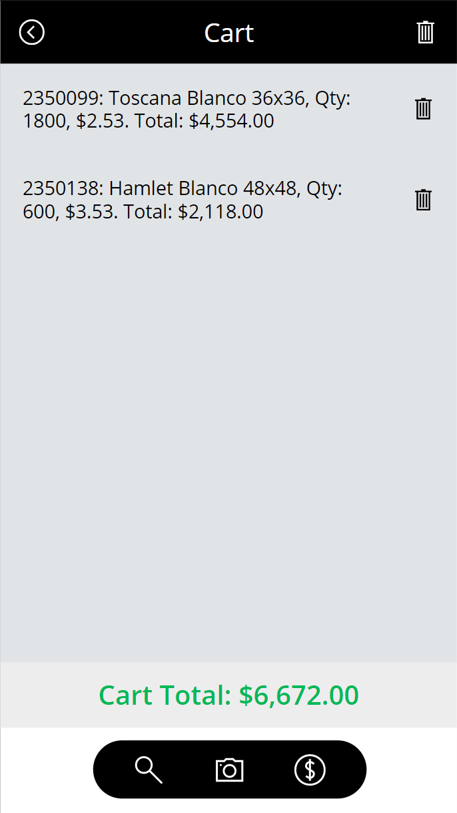
Cart

Slide 14

DEMO 1
App Intro
Notes:
SRM - Power Apps

Slide 16
DEMO 2
Cart
Notes:
SRM - Power Apps

Slide 18
DEMO 3
Edit / Add Product
Notes:
SRM - Power Apps

Slide 20
DEMO 4
Photos
Notes:
SRM - Power Apps

Slide 22
DEMO 5
Bonus
Notes:
SRM - Power Apps

Slide 24


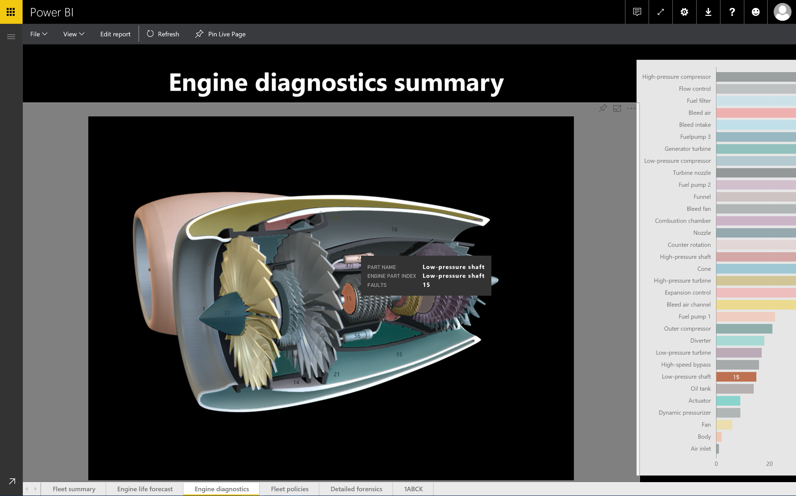
End

Slide 25
Summary
Search
Product Details
Product Photos
Edit Product
Add Product
Cart
Search by Photo (AI)
Mixed Reality (AI)
Resources

Slide 26
Resources
SRM - Power Apps
fleitasarts.com
github.com/hfleitas/srm
ROI Case Study
Notes:
SRM - Power Apps

Slide 27
Hiram Fleitas
Owner Fleitas Arts
@hiramfleitas
Thank You
hiram@fleitasarts.com
fleitasarts.com
/hfleitas
hiramfleitas

